Slide 1
Global Campus Records Management Awareness Series
Session 3: Best Practice for Records Management- How to Dispose of Records Correctly

Slide 2
Outline
Importance of Records Management
UARMP Programme Roles & Responsibilities
UARMP Policy Statements
Disposition Process

Slide 4
What is a University record?
“Recorded information in all formats or characteristics generated, received and maintained by the University in pursuance of its objectives and obligations under the University charter, Statues and Ordinances and in transacting University business and kept as evidence of such transactions” ( Sect. 17.1, UARMP, 2021).

Slide 5
What are Records?
Any recorded information, regardless of medium or characteristics, made or received and retained by an organization in pursuance of legal obligations or in the transaction of business (ARMA International, 2016, p. 43).

Slide 6
What is records management?
IS0 15489-1 Standards for Records Management defines records management as :
The field of management responsible for the efficient and systematic control of the creation, receipt, maintenance, use and disposition of records, including processes for capturing and maintaining evidence of and information about business activities and transactions in the form of records (ISO, 2016, p. 3).

Slide 7
Importance of Records Management
Business
Continuity
Productivity &
Efficiency
Data Protection
Records Management
Legal
Defensibility
Institutional
Memory

Slide 8
University Archives and Records Management Programme (UARMP) Structure – GLOBAL CAMPUS
University Registrar
University Archivist
Global Campus
Campus
Registrar
Campus
Records
Manager

Slide 9
UARMP Policy Statements
The UWI retains its records for appropriate periods of time taking into account legal, regulatory, fiscal and operational requirements( Sect. 10.1, UARMP, 2021).
All records are created for a purpose whether, administrative or operational and they have value for as long as they continue to be useful and needed in conducting university business. No university record shall be destroyed without an approved records retention and disposition authority( Sect. 10.2, UARMP, 2021).

Slide 10
UARMP Policy Statements
Any member of the University staff who knowingly destroys or approves the premeditated destruction of University records which are unscheduled or which are known to be scheduled for transfer to the Archives or who refuses to comply with approved records retention and disposition authorities may be subject to disciplinary action( Sect. 10.5, UARMP, 2021).

Slide 11
Records Life Cycle
Creation/Receipt-A record is created or received during the course of business
Use & Maintenance-The record is actively used for current business operations and is frequently referenced or accessed
Disposition-Records that are not frequently referenced and are passed their useful life, or records based on their historical value are in need of long term preservation

Slide 12
Disposition Process

Slide 13
Step 1- Contact RIM Unit
Email RIM Unit indicating the type of records to be disposed of e.g Invoices

Slide 14
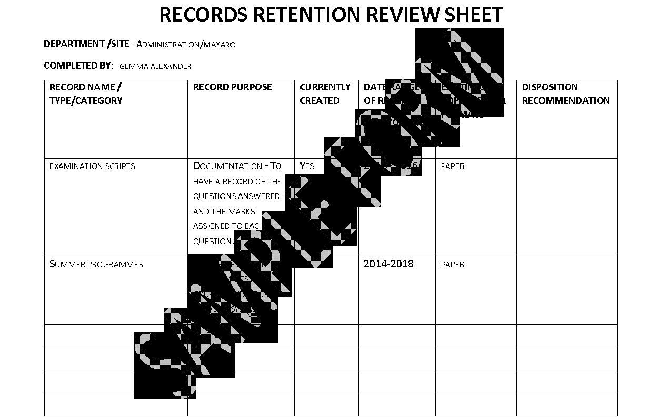

Slide 15
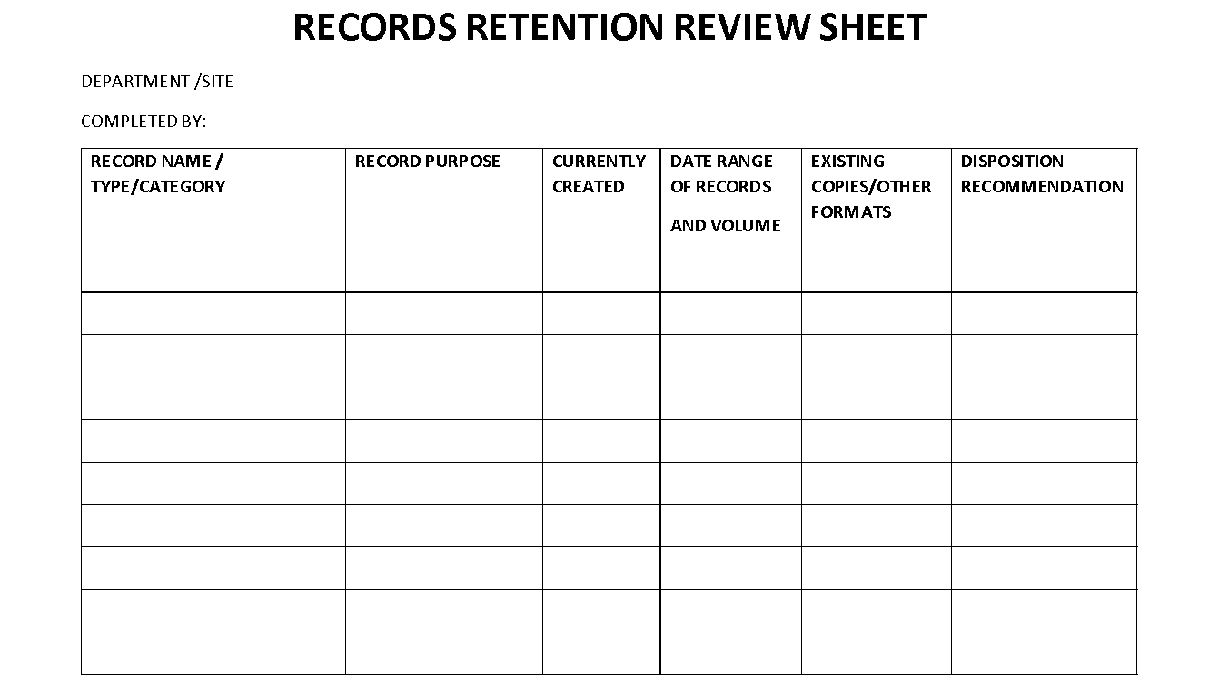
Step 2- Complete Records Retention Review Sheet

Slide 16
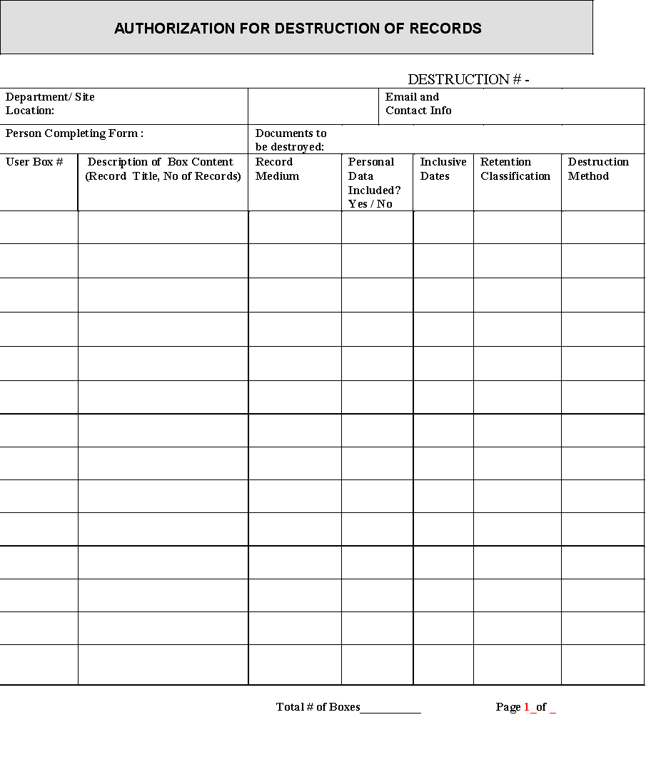
Step 3- Complete Authorization for Destruction of Records Form

Slide 17
DESTRUCTION APPROVALS
------------------------------------------------------------------------------- ------------------------- -----------------
APPROVING DEPARTMENT/ SITE OFFICIAL (PRINT NAME) SIGNATURE DATE
_________________________________________ _________________________
CAMPUS RECORDS MANAGER DATE
DOCUMENTS DESTROYED BY: _____________________________________________ _________________
NAME (PRINT OR SIGNATURE) DATE OF DESTRUCTION

Slide 18
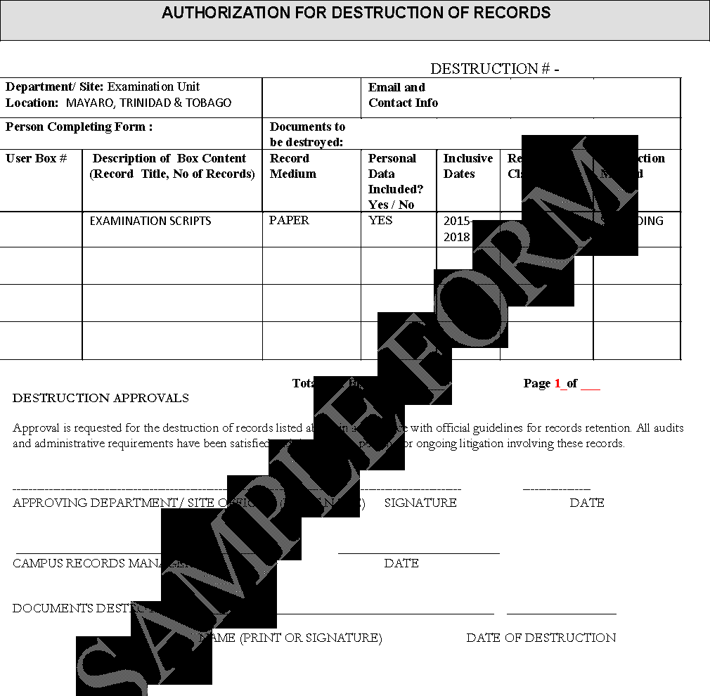

Slide 19
Thank you
Questions?

